Slide 1
JavaScript

Slide 2
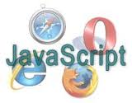
Overview
JavaScript is a scripting language
Used for add real programming to webpages.
The main benefit of JavaScript is to add interaction between the website and its visitors
JavaScript is a client-side scripting language.
This means the web browser will be running the script.

Slide 3
Scripting language
Script language is a programming language
Scripts can be written and executed "on-the-fly", without explicit compile and link steps;
Script is typically reserved for small programs (up to a few thousand lines of code).
Most widely used scripting languages are
JavaScript
VBScript
PHP,
Perl
Python
Ruby
ASP and Tcl.

Slide 4
Scripting language
One common different between a scripting language and a languages used for writing entire applications is that
Whereas a programming language is typically compiled first before allowed to run,
Scripting languages are interpreted from source code or byte code one command at a time.

Slide 5
What is JavaScript?
JavaScript is a scripting language that enables web developers/designers to build more functional and interactive websites.
Common uses of JavaScript include:
Alert messages
Popup windows
Dynamic dropdown menus
Form validation
Displaying date/time
JavaScript usually runs on the client-side (the browser's side),

Slide 6
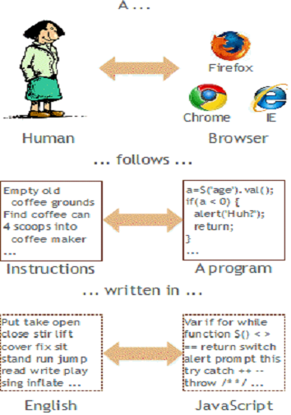
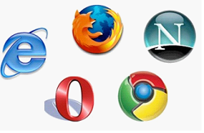
What You Need to Use JavaScript?
Know how to use HTML
Have a web browser
Know how to do programming

Slide 7
What JavaScript can do for you
JavaScript allows you to create highly responsive interfaces
Provide dynamic functionality, without having to wait for the server to react and show another page.
Fast, no connection needed once loaded
Simpler execution model: don't need compiler or development environment
Platform-independence: code interpreted by any script-enabled browser
Slower than compiled code, not as powerful/full-featured

Slide 8
Limitations with JavaScript
JavaScript cannot write to files on the server
JavaScript cannot access databases
JavaScript cannot close a window if it didn't open it.
JavaScript cannot protect your page source or images
JavaScript doesn't have any multithreading or multiprocess capabilities.

Slide 9
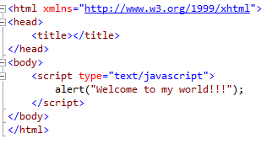
JavaScript Syntax
A JavaScript consists of JavaScript statements that are placed within the
<script> type="text/javascript"> and </script> tell where JavaScript starts and ends.
<script>... </script>

Slide 10
JavaScript Syntax
JavaScript is case sensitive.
Certain characters and terms are reserved.
JavaScript is simple text (ASCII).
Each code statement has to end with a semicolon (;).
JavaScript ignores spaces, tabs, and newlines that appear in JavaScript programs

Slide 11
Where to put your scripts?
Place scripts in any of the following locations:
Between the HTML document's head tags.
Within the HTML document's body (i.e. between the body tags).
In an external file (and link to it from your HTML document).

Slide 12
Comments in JavaScript:
Single Line Comments:
Any text between a // and the end of a line is treated as a comment
Any Text between a<!– closing sequence //-->
Multiple lines.
Any text between the characters /* and */ is treated as a comment. This may span multiple lines.

Slide 13
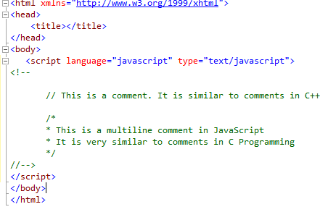
Comments in JavaScript:

Slide 14
JavaScript DataTypes
JavaScript allows you to work with three primitive data types:
Numbers eg. 123, 120.50 etc.
Strings of text e.g. "This text string" etc.
Boolean e.g. true or false.
Java does not make a distinction between integer values and floating-point values.
All numbers in JavaScript are represented as floating-point values.

Slide 15
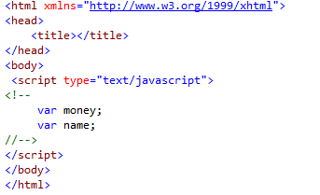
JavaScript Variables
Variables can be thought of as named containers.
Place data into these containers and then refer to the data simply by naming the container.
Before use a variable in a JavaScript program, must declare it.
Variables are declared with the var keyword

Slide 16
JavaScript Variables
JavaScript is untyped language.
This means that a JavaScript variable can hold a value of any data type.
Unlike many other languages, don't have to tell JavaScript during variable declaration what type of value the variable will hold.
The value type of a variable can change during the execution of a program and JavaScript takes care of it automatically.

Slide 17
JavaScript Variable Scope
JavaScript variable will have only two scopes.
Global Variables:
A global variable has global scope which means it is defined everywhere in your JavaScript code.
Local Variables:
A local variable will be visible only within a function where it is defined. Function parameters are always local to that function.

Slide 18
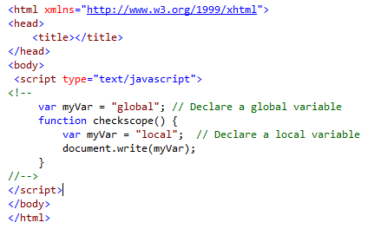
JavaScript Variable Scope

Slide 19
JavaScript Variable Names
Should not use any of the JavaScript reserved keyword as variable name.
JavaScript variable names should not start with a numeral (0-9).
Must begin with a letter or the underscore character.

Slide 20
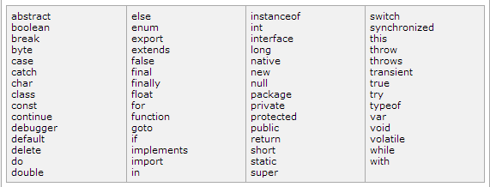
JavaScript Reserved Words

Slide 21
JavaScript Operators
JavaScript language supports following type of operators.
Arithmetic Operators: (+,-,/,*,%,++,--)
Comparision Operators: (==,!=,<=,>=,<,>)
Logical (or Relational) Operators: (&&,||,!)
Assignment Operators: (=,+=,-=,*=,/=)
Conditional (or ternary) Operators: (?: )

Slide 22
Conditional Statement
JavaScript supports conditional statements which are used to perform different actions based on different conditions.
JavaScript supports following forms of if..else statement:
if statement
if...else statement
if...else if... statement.
Switch

Slide 23

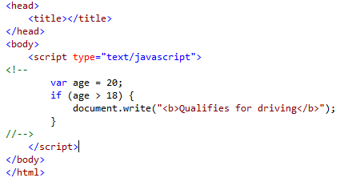
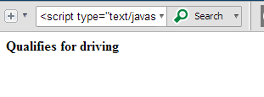
if statement:
Output

Slide 24
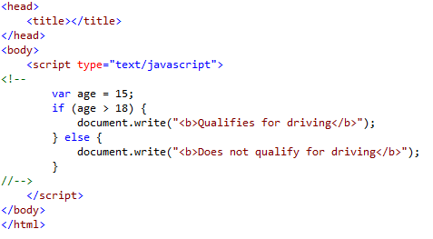
if...else statement:
Syntax
if (expression)
{
Statement(s) true
}
Else
{
Statement(s) false
}

Slide 25
if...else if... statement:
Syntax
if (expression 1)
{
Statement(s) to be executed if expression 1 is true
}
else if (expression 2)
{
Statement(s) to be executed if expression 2 is true
}
else if (expression 3)
{
Statement(s) to be executed if expression 3 is true
}
Else
{
Statement(s) to be executed if no expression is true
}

Slide 26
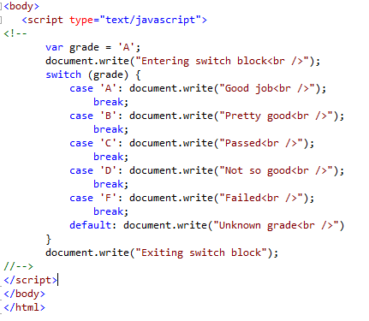
Switch Case
Syntax
switch (expression)
{
case condition 1: statement(s) break;
case condition 2: statement(s) break; ...
case condition n: statement(s) break;
default: statement(s)
}

Slide 27
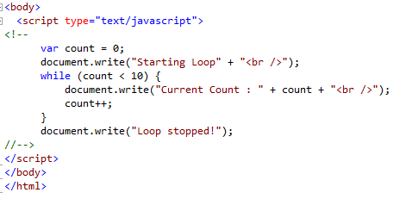
Control Statements
while Loop
while (expression)
{
Statement(s) to be executed
if expression is true
}

Slide 28
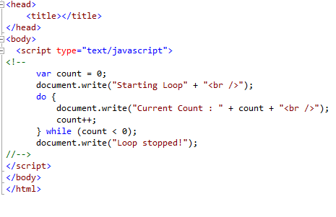
do...while Loop
Syntax
do{
Statement(s) to be executed;
} while (expression);

Slide 29
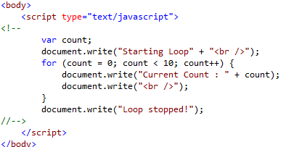
for Loop
Syntax
for (initialization; test condition; iteration statement)
{
Statement(s) to be executed if test condition is true
}

Slide 30
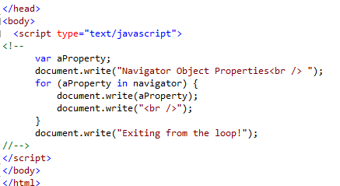
for...in loop
Syntax
for (variablename in object)
{
statement or block to execute
}

Slide 31
Loop Control
JavaScript provides break and continue statements.
These statements are used to immediately come out of any loop or to start the next iteration
break
continue
continue statement tells the interpreter to immediately start the next iteration of the loop and skip remaining code block.

Slide 32
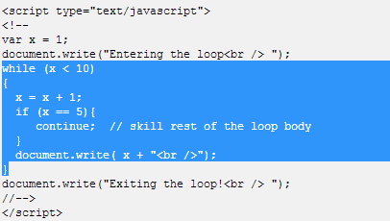
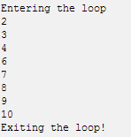
Loop Control
Output

Slide 33
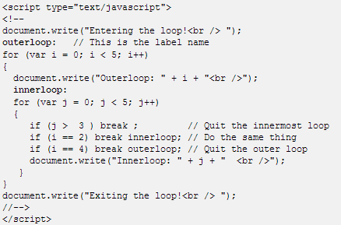
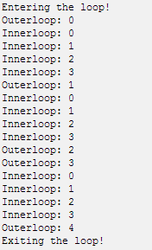
Labels to Control the Flow
A label is simply an identifier followed by a colon that is applied to a statement or block of code.
Output

Slide 34
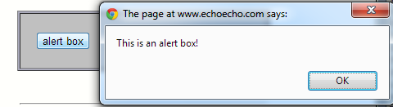
POP UP BOXES
Three different kinds of popup windows.
Alert
Confirm
Prompt
ALERT BOX
The syntax for an alert box is: alert("yourtext");
The user will need to click "OK" to proceed.
Typical use is when you want to make sure information comes through to the use

Slide 35
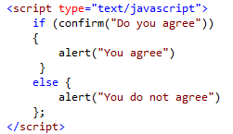
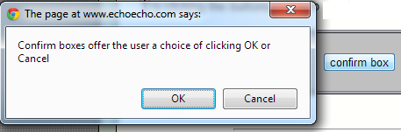
POP UP BOXES
CONFIRM BOX:
The syntax for a confirm box is: confirm("yourtext");
The user needs to click either "OK" or "Cancel" to proceed.
Typical use is when you want the user to verify or accept something.

Slide 36
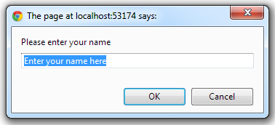
POP UP BOXES
PROMPT BOX
The prompt box syntax is: prompt("yourtext","defaultvalue");
The user must click either "OK" or "Cancel" to proceed after entering the text.
Typical use is when the user should input a value before entering the page.

Slide 37
Events
JavaScript's interaction with HTML is handled through events
Events are actions
A few example of events:
A mouse click
The webpage loading
Mousing over a hot spot on the webpage, also known as hovering
Selecting an input box in an HTML form
A keystroke

Slide 38
Standard Events
Event | Description
onchange | Script runs when the element changes
onsubmit | Script runs when the form is submitted
onreset | Script runs when the form is reset
onselect | Script runs when the element is selected
onfocus | Script runs when the element gets focus
onkeydown | Script runs when key is pressed
onkeypress | Script runs when key is pressed and released

Slide 39
Standard Events
Event | Description
onmousedown | Script runs when mouse button is pressed
onmousemove | Script runs when mouse pointer moves
onmouseout | Script runs when mouse pointer moves out of an element
onmouseover | Script runs when mouse pointer moves over an element
onmouseup | Script runs when mouse button is released
onkeyup | Script runs when key is released
onclick | Script runs when a mouse click
ondblclick | Script runs when a mouse double-click

Slide 40
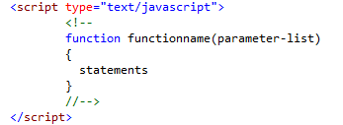
JavaScript Functions
A function is a group of reusable code which can be called anywhere in program
Divide big program in a number of small and manageable functions.
Before use a function we need to define that function.
Define a function in JavaScript is by using the function keyword

Slide 41

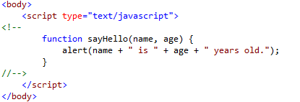
JavaScript Functions
Calling a Function
To invoke a function somewhere later in the script, you would simple need to write the name of that function
Function Parameters

Slide 42
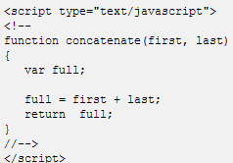
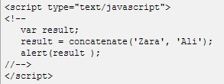
JavaScript Functions
The return Statement
This is required if you want to return a value from a function.

Slide 43
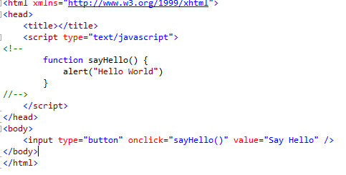
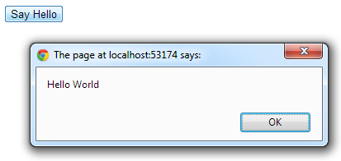

JavaScript Functions

Slide 44
Arrays
The Array object let's you store multiple values in a single variable.
Arrays are simply an ordered stack of data items with the same data type.
Some programming languages start arrays at zero, other start at one. JavaScript arrays start at zero.
Creating an array
Assigning values to the array
var array_name = new Array(number_of_elements)
array_name[0] = "Array element"

Slide 45
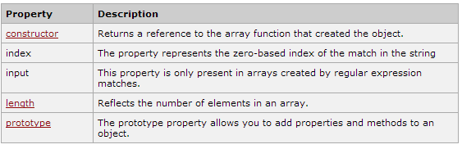
Arrays
var faq = new Array(3)
faq[0] = "What are JavaScript arrays"
faq[1] = "How to create arrays in JavaScript?"
faq[2] = "What are two dimensional arrays?"
Displaying Array Elements
document.write(faq[1])
Result: How to create arrays in JavaScript?
Array Properties

Slide 46
Array Methods
Method | Description
concat() | Returns a new array comprised of this array joined with other array(s)
pop() | Removes the last element from an array
push() | Adds one or more elements to the end of an array
reverse() | Reverses the order of the elements of an array -- the first becomes the last, and the last becomes the first.
toString() | Returns a string representing the array and its elements.
join() | Joins all elements of an array into a string.

Slide 47
Summary
The basic JavaScript explained in this section
This is where the real fun starts with JavaScript:
Start controlling the single objects (form fields, buttons, images, menus, etc. etc.) on the pages.

Slide 48


